Slide 1


Automated Test Oracles for
Machine Learning Software
PD Dr. Steffen Herbold
© All rights reserved

Slide 2
Contents
Motivation
Oracles and pseudo oracles
Trivial Oracles

Slide 3










Machine Learning Software

Slide 4

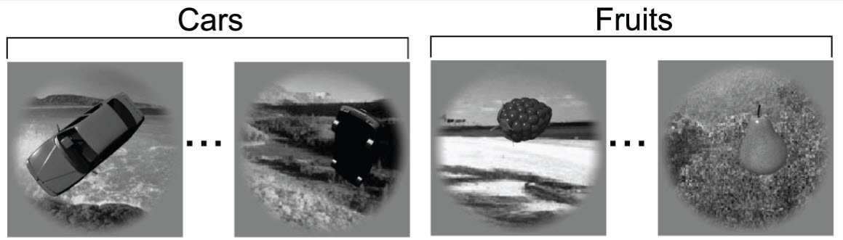

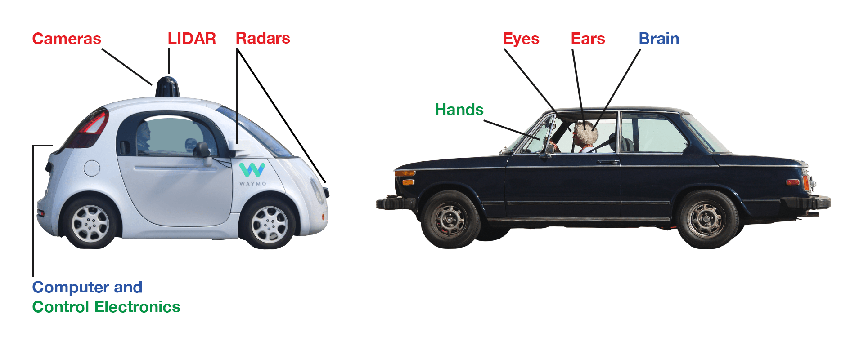
Modern Applications
Fraud Detection
Object Recognition
Credit Scoring
Autonomous Driving

Slide 5
Machine Learning and Safety
ISO 26262 Standard: Road vehicles – Functional safety
Part 6: Product development at the software level

Slide 6
ISO 26262 Standard
Automotive Safety Integrity Level D (ASIL D)
  „ASIL D represents likely potential for severely life-threatening or fatal injury in the event of a malfunction and requires the highest level of assurance that the dependent safety goals are sufficient and have been achieved.”
Defines requirements for quality assurance

Slide 7




Testing of Machine Learning
Test Data
Model
Training Data
Learning Algorithm
Evaluation with ML Metrics

Slide 8
Excerpt from ISO 26262
Quality assurance for ASIL-D:
  Equivalence class analysis
  Boundary value analysis
  Modified Condition / Decision Coverage
  ….

Slide 9

Requires Complex Testprozess
Correctness
Specification
Robustness
Boundaries
Coverage
Exception Scenarios
Equivalence Classes

Slide 10

Testing Machine Learning Software
for Dummies

Slide 11


Scientific
Literature?

Slide 12
Contents
Motivation
Oracles and pseudo oracles
Trivial Oracles

Slide 13

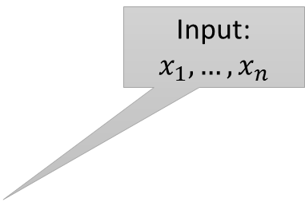
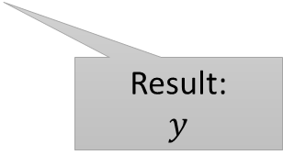
Software Testing!
Input:
$$x_{1},…, x_{n}$$
Test Driver
Test Case 1
…
Test Case n
Result 1
Expectation 1
Expectation:
$$y^{∗}$$
Test Object
…
…
Result n
Expectation n
Result:
$$y$$

Slide 14
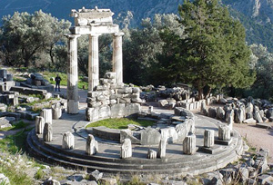

The Test Oracle
Determines the expectation $y^{∗}$

Slide 15
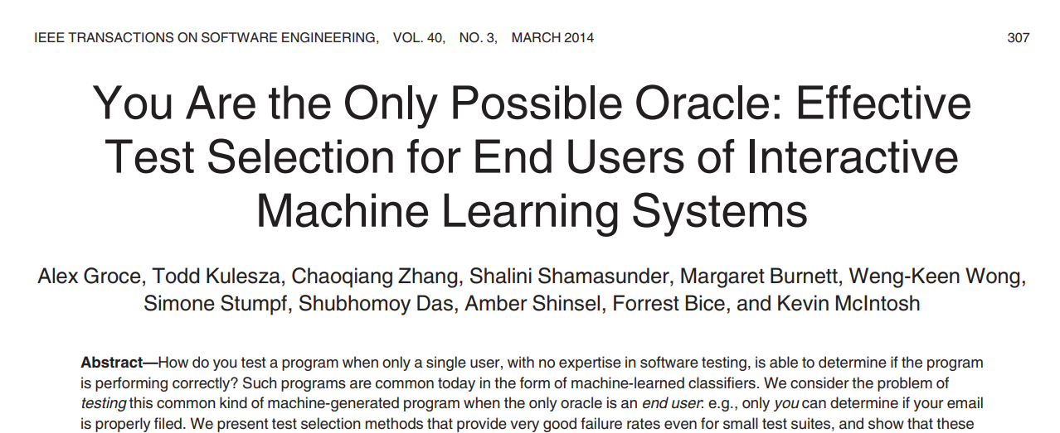
The Oracle Problem

Slide 16

Testing with Pseudo Oracles
Simulates a real oracle
Usefull to validate properties of algorithms
M. D. Davis and E. J. Weyuker, “Pseudo-oracles for non-testable programs,” in Proceedings of the ACM ’81 Conference,

Slide 17
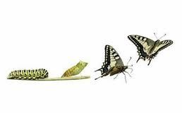

Pseudo Oracles for Machine Learning
Approach 1: Metamorphic Testing
Approach 2: Comparison of different implementations
C. Murphy, G. E. Kaiser, and M. Arias, “An approach to software testing of machine learning applications.” in SEKE, vol. 167, 2007.

Slide 18

Approach 1:
Metamorphic Testing
How does the output change, if I manipulate the input?

Slide 19



Metamorphisches Testen
Training Data
Original Model
Morphism
Comparison
Learning Algorithm
Morphed
Training Data
Morphed Model

Slide 20
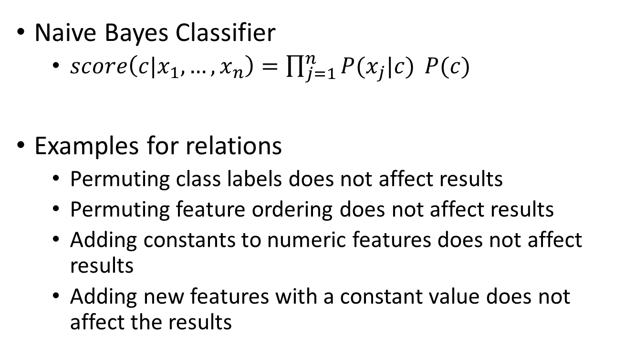
Metamorphische Relations
Feature
Class Label
Naive Bayes Classifier
  $score\left(c|x_{1},…, x_{n}\right)=\prod_{j=1}^{n}{P(x_{j}|c)} P(c)$
Examples for relations
  Permuting class labels does not affect results
  Permuting feature ordering does not affect results
  Adding constants to numeric features does not affect results
  Adding new features with a constant value does not affect the results
X. Xie, J. W. Ho, C. Murphy, G. Kaiser, B. Xu, and T. Y. Chen, “Testing and validating machine learning classifiers by metamorphic testing,” Journal of Systems and Software, vol. 84, no. 4, pp. 544 – 558, 2011

Slide 21
Approach 2: Testing through other implementations
Does my algorithm yield the same results as the competition?

Slide 22
Comparison of Implementations
Implementation A
Model A
Training Data
Comparison
Implementation B
Model B

Slide 23
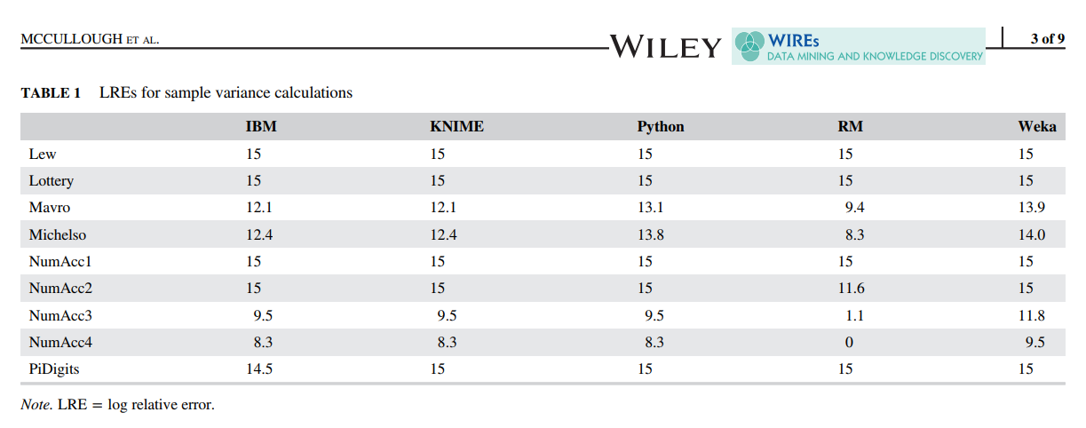
Comparison of Linear Regression
McCullough B. D., Mokfi Taha, Almaeenejad Mahsa. On the accuracy of linear regression routines in some data mining packages. WIREs Data Mining Knowl Discov 2018. doi: 10.1002/widm.1279

Slide 24
Contents
Motivation
Oracles and pseudo oracles
Trivial Oracles

Slide 25
Testing of Classification Algorithms
Pilot study
  Simple metamorophic test that can be applied to (almost) any classification algorithm
  Automated tests for basic functioning → Smoke testing
  Application of tests to state-of-the-art software

Slide 26
Six Metamorphic Tests
Same results, if
  the data does not change
  1 is added to all numeric features
  the order of the instances changes
  the order of the features changes
  meta data changes
The results are the opposite, if
  the class labels are inverted

Slide 27

Smoke Testing
Validate basic properties of implementation
  No crashes
  Return values exist are not Null
  …
For machine learning
  Models can be trained
  Predictions can be made
  → No oracle required!

Slide 28
Design of the Smoke Tests
What are good training/test data for smoke tests?

Slide 29

22 Smoke Tests for Classification
Data in [0,1]
Features close to machine precision
Random classes
Alle numeric values 0
Only single value in a class
…

Slide 30
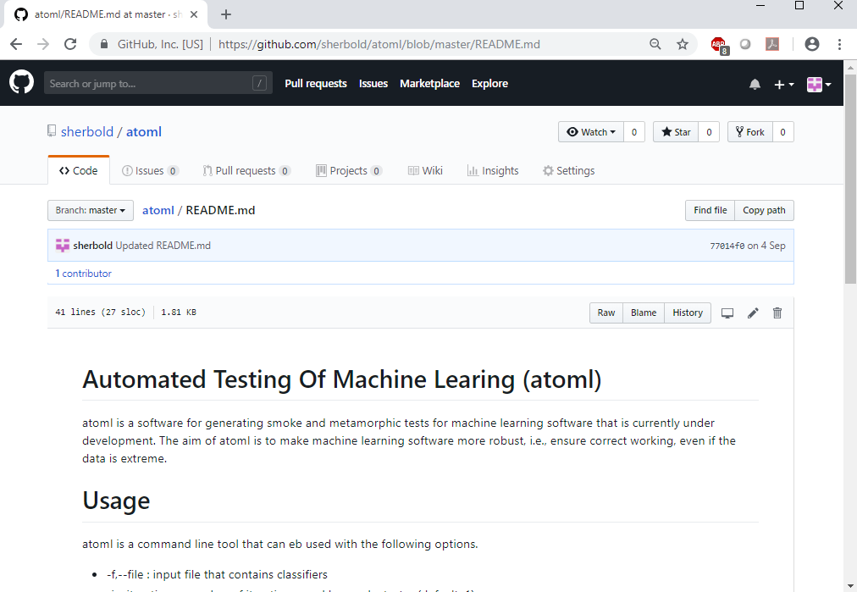
Prototype „atoml“

Slide 31

Results for Weka
Decision trees crash with data from$\left[0, 1.7⋅{10}^{308}\right].$
Reason: stack overflow due to recursion
Only two algorithm passed
all tests!
Nur zwei Algorithmen komplett ohne Probleme
+1 change change results
Permutations of change results
Keine Probleme, wenn sich die Daten nicht ändern
No problem if the data does not change

Slide 32
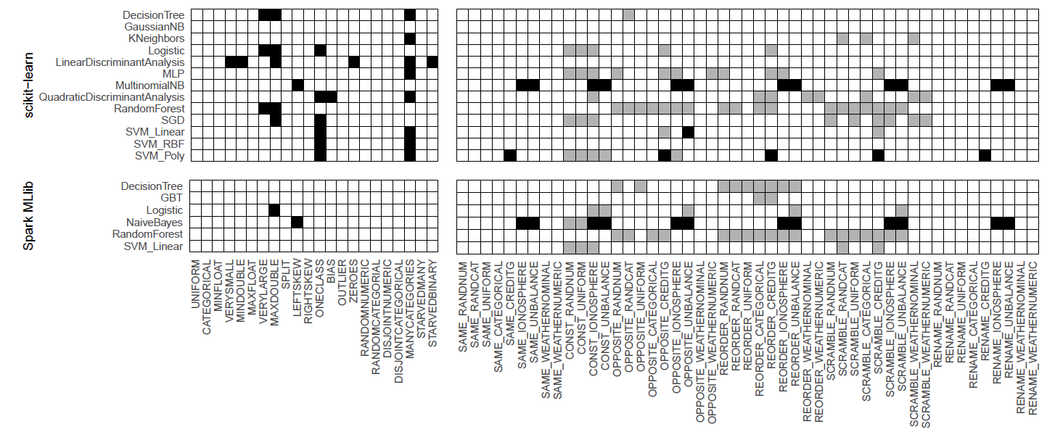
Results for scikit-learn and Spark

Slide 33

Developer Feedback
wekalist@list.waikato.ac.nz
scikit-learn@python.org
dev@spark.apache.org

Slide 34

Positive Feedback
„This is definitely helpful!“
“This sounds like a useful tool. “
“Thanks for sharing your analysis. We really need more work in this direction.“
“Do you have any interest in applying your knowledge to industry?“

Slide 35

„However“ …
„However, I wanted to point out …“
„…not all your expectations are warranted…”
“I suspect that…“

Slide 36
Deviations not Always Wrong
Minibatches and Bagging
  Instances/features are subdivided
  Partitions depend on random seed and order of data
Asymmetric initializations
  Order as tie breaker

Slide 37

Users vs. Devs
“We could try and document all the cases where the result will not fulfill these invariances, but I think that might be too much.
At some point we need the users to understand what's going on. If you look at the random forest algorithm and you fix
the random state it's obvious that feature order matters. “
- Scikit-Learn Core Developer
How should I know every detail?
… Weka‘s random forest fulfills this property

Slide 38
Deviation vs. Significance
“Was the final difference in accuracy statistically significant?” – Creator of Apache Spark

Slide 39
Further Steps
Significance tests for differences
Algorithm specific metamorphic tests
Other types of algorithms, e.g., clustering
Use combinatorical testing

Slide 40
Hyperparameters and Testing
How do hyper parameters affect my tests?

Slide 41
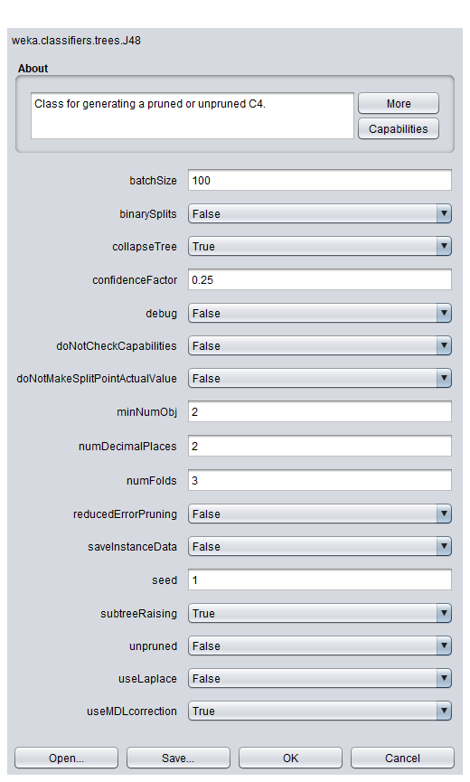
Combinatorical Testing
… of hyper parameters
J. Chandrasekaran, H. Feng, Y. Lei, D. R. Kuhn, and R. Kacker,
“Applying combinatorial testing to data mining algorithms,” in
2017 IEEE International Conference on Software Testing, Verification and Validation Workshops (ICSTW), March 2017, pp. 253–261.

Slide 42
Agenda
Einführung und Motivation
Das Orakelproblem und Pseudoorakel
Fallstudie für Klassifikationsprobleme
Ausblick und Zusammenfassung

Slide 43

The Future (?)
Quality Assurance
Machine Learning
Joined Conferences
Tools and Methods
(Modification of) Standards

Slide 44

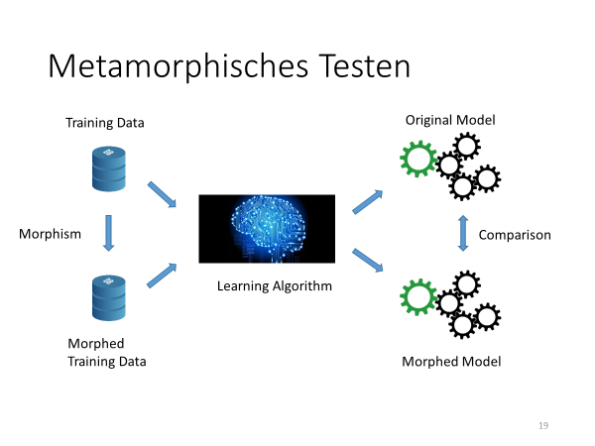

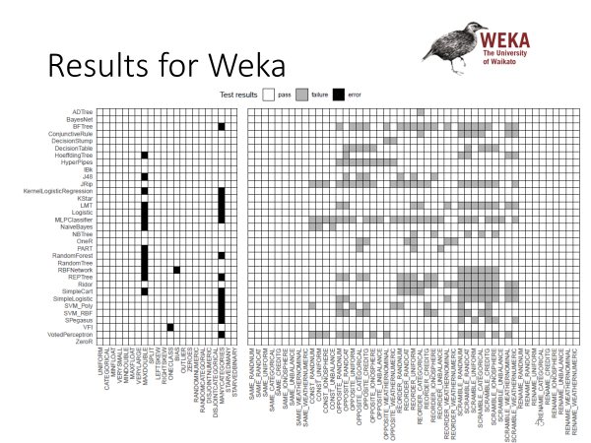
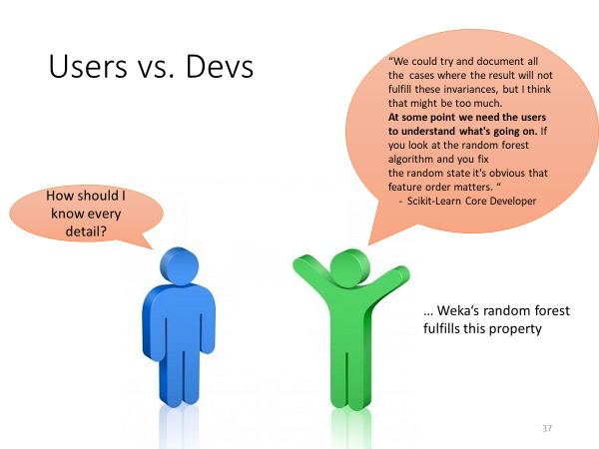
Summary

